Slide 1

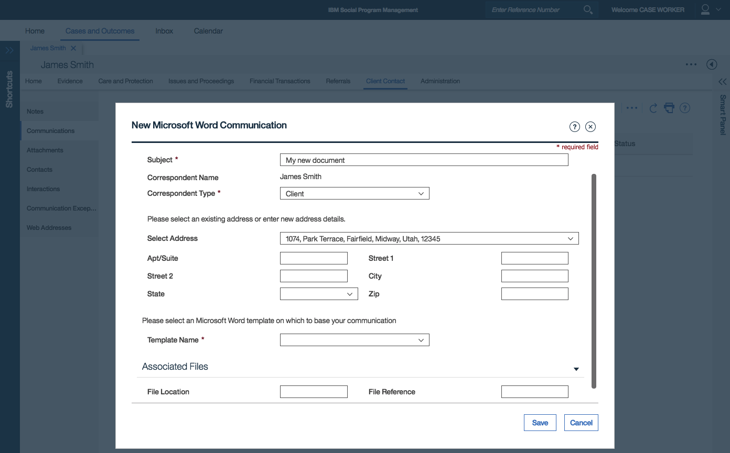
CURAM LAUNCHES MSWORD WORD
CURAM OPENS DOTX IN MSWORD
CURAM SAVES DOC TO DB
CURAM SENDS IN VARIABLE DATA USING MS API
CURAM SAVES DOC TO DB
CASEWORKER CAN EDIT / SAVE
OLD WAY
Curam DB
CURAM
DOTX
DOCX
Variable data
James Smith,
Broad Street,
…

Slide 2
NEW WAY
Curam DB
CURAM PROVIDES DOWNLOAD LINK
CASEWORKER OPENS IN ANY APP
CASEWORKER UPLOADS WHEN FINISHED
Server Gen
DOTX
DOCX
Variable data
James Smith,
Broad Street,
…

